Slide 1
Model-based Systems Engineering (MBSE) Initiative Overview
Sanford Friedenthal
Mark Sampson

Slide 2
INCOSE MBSE Initiative Overview

Slide 3
MBSE Initiative Charter
Supports MBSE Component of the SE Vision 2020
Promote, advance, and institutionalize the practice of MBSE through broad industry/academic involvement
Research
Standards
Processes, Practices, & Methods
Tools & Technology
Outreach, Training & Education
MBSE Wiki
http://www.omgwiki.org/MBSE/doku.php

Slide 4
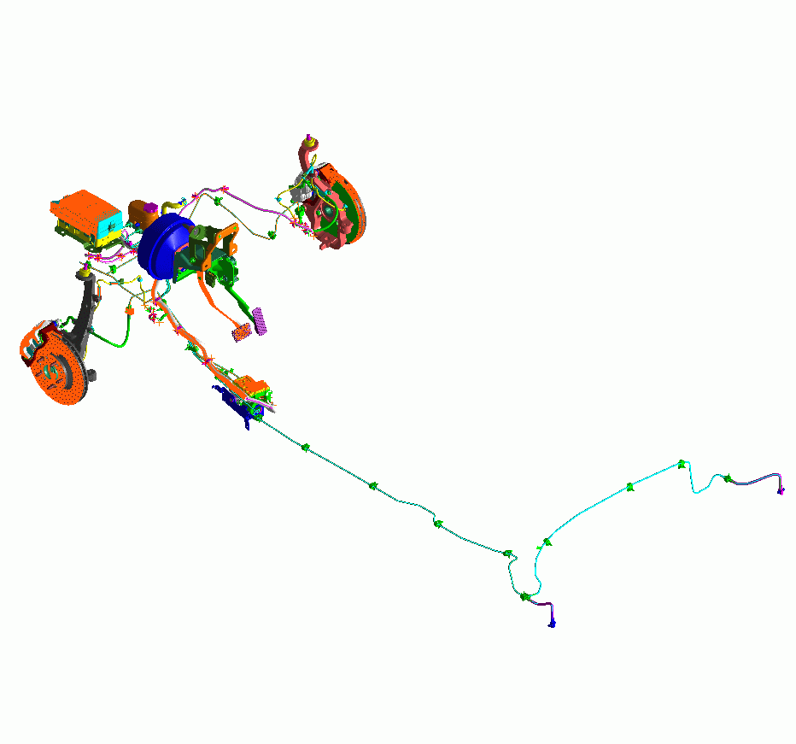
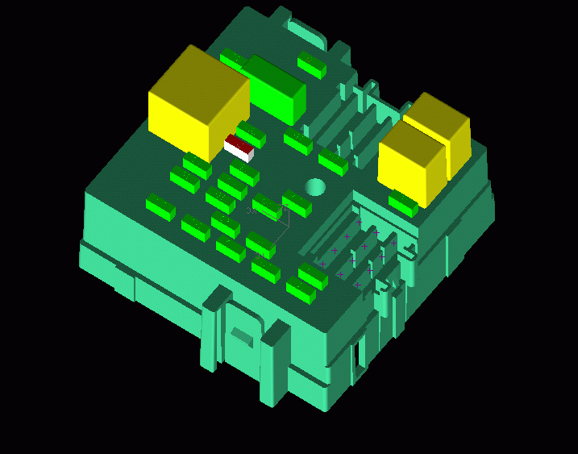
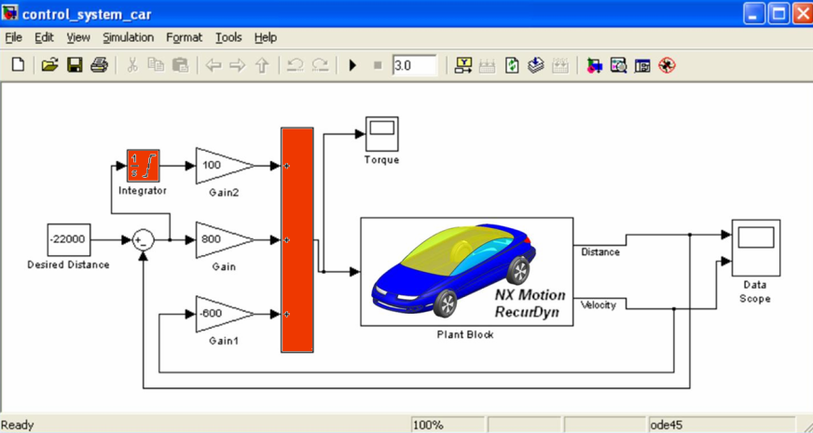
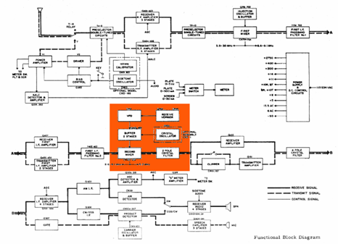
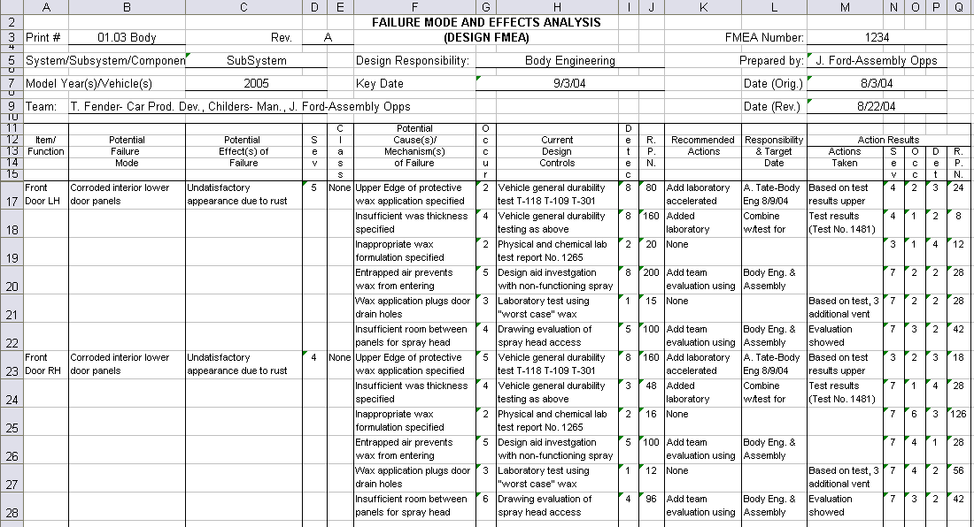
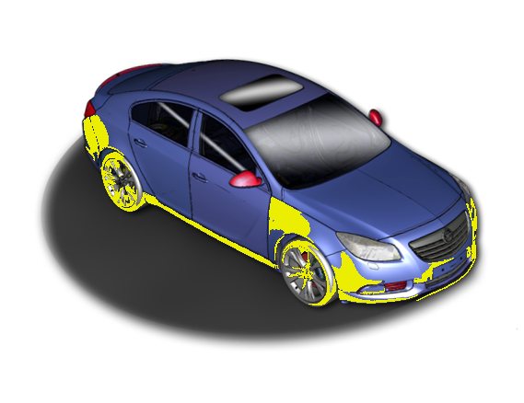
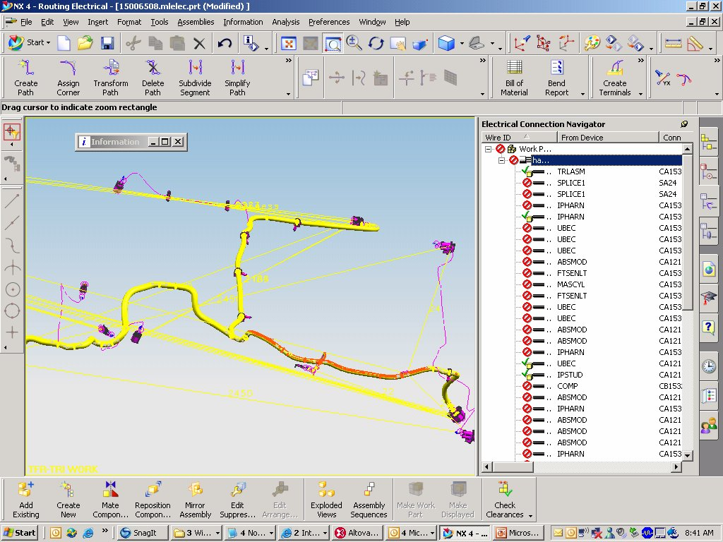
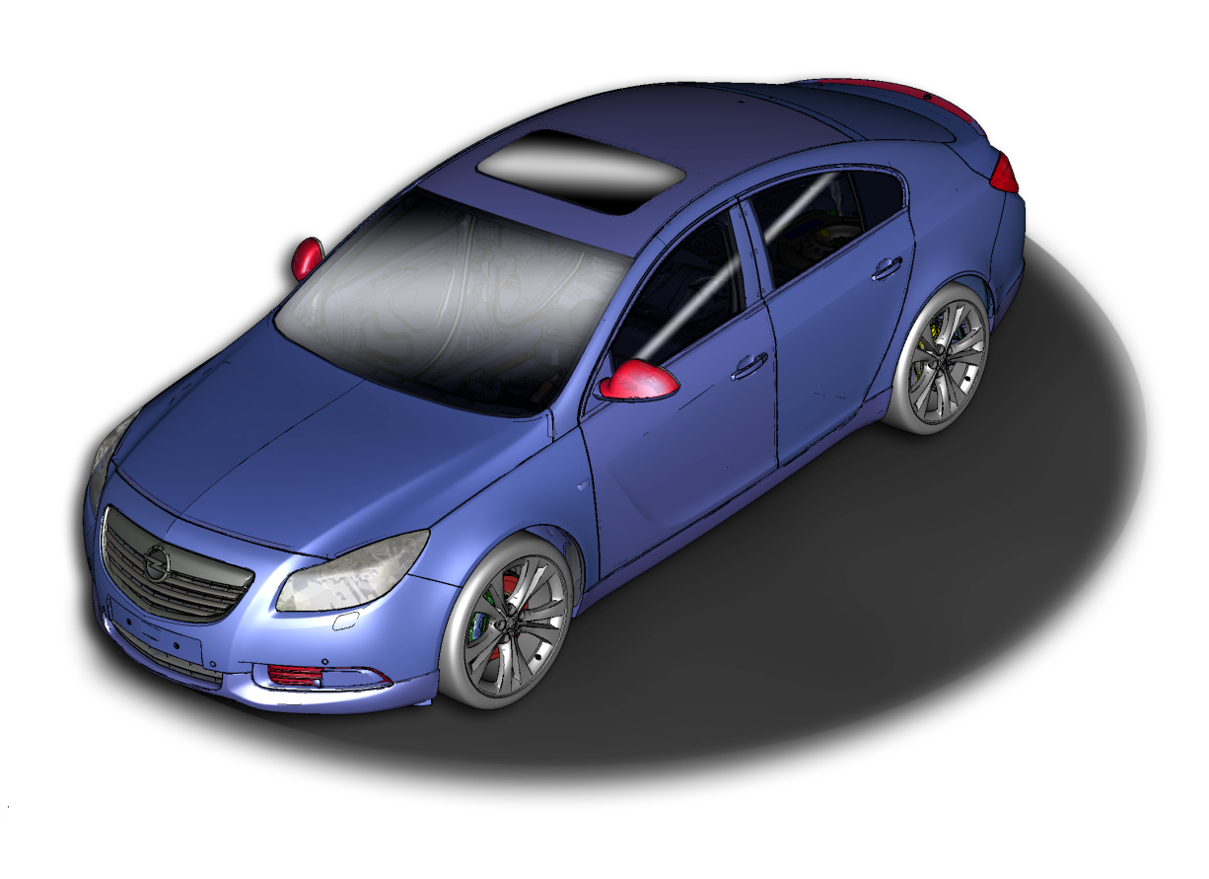
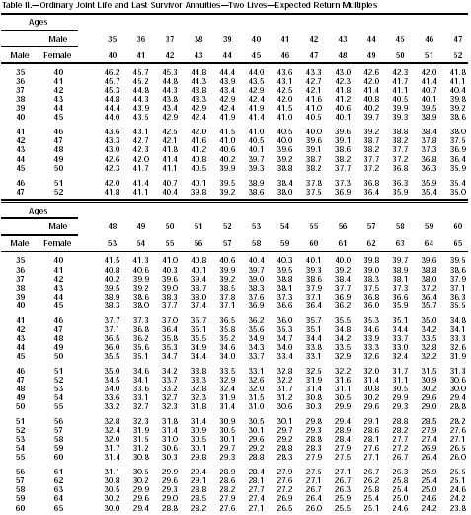
Integrated Systems Engineering Vision
Hydraulic Fluid: SAE 1340 not-compliant
Power Rating: 18 Amps
Thermal/Heat Dissipation: 780°
Ergonomic/Pedal Feedback: 34 ERGS
Hydraulic Pressure: 350 PSI
Sensor MTBF: 3000 hrs
Automatic Cruise Control <FAULT>
Minimum Turn Radius: 24 ft.
Dry Pavement Braking Distance at 60 MPH : 110 ft. 90 ft
Minimum Turn Radius: 24 ft.
Dry Pavement Braking Distance at 60 MPH : 110 ft.
4
Notes:
If we can pull this off we can achieve this ultimate vision for integrated requirements…, visualizing where requirements go and how they interact with various systems… For example, …starting with the car, what are the requirements associated with the front end of this vehicle.
Shows current requirements by graphically clicking on the car…
What about changing a requirement…stopping distance
Show the potential impact of changing stopping distance including…
Thermal/heat problems with brakes
Ergonmic feedback problems with brake pedal
Hydraulic fluid rating violation
Failure modes/MTBF rating problems with sensors
Hydraulic pressure problems
Electrical fault problems
Zooming into the electrical box, highlights a fuse
Clicking into the fuse brings up the schematic and highlights a fuse link
Clicking into the schematic zooms in on the wire harness that has the problem—including the signal for a failed sensor that in this particular failure mode causes the short.
…which allows us to go look at the Failure Modes document and update appropriately.
Updating the software to handle that fault
…and even seeing the impact on our safety rating and insurance costs.

Slide 5
INCOSE MBSE Roadmap
Reduced cycle times
System of systems
interoperability
Design optimization across broad trade space
Cross domain effects based analysis
MBSE Capability
Extending Maturity and Capability
Institutionalized
MBSE across
Academia/Industry
Distributed & secure model repositories
crossing multiple domains
Defined MBSE theory, ontology, and formalisms
Well Defined MBSE
Refer to activities in
the following areas:
Maturity
Architecture model integrated
with Simulation, Analysis, and Visualization
Planning & Support
Research
Standards Development
Processes, Practices, & Methods
Tools & Technology Enhancements
Outreach, Training & Education
Matured MBSE methods and metrics,
Integrated System/HW/SW models
Ad Hoc MBSE
Document Centric
Emerging MBSE standards
2010
2010
2020
2025

